Slide 1
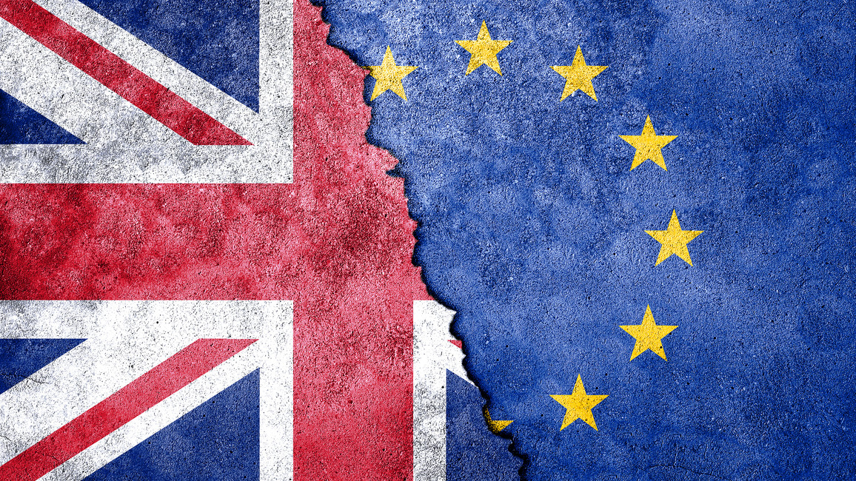
Brexit
presented by King Luka in March of 2024
Source: https://www.bmbf.de/bmbf/shareddocs/kurzmeldungen/de/was-bedeutet-der-brexit-fuer-bildung-und-forschung.html

Slide 2

Content
General information
Great Britain before Brexit
Reasons for Brexit
EU-Membership referendum
Trade and cooperation agreements
Consequences for Great Britain
Consequences for EU
Sources
Source: https://www.instituteforgovernment.org.uk/article/explainer/what-brexit-means-individuals
Notes:
Luka: (introduction), general information, Great Britain before Brexit, Reasons for Brexit, EU-Membership referendum
Enoch: Trade and cooperation agreement, consequences for great britain and EU

Slide 3
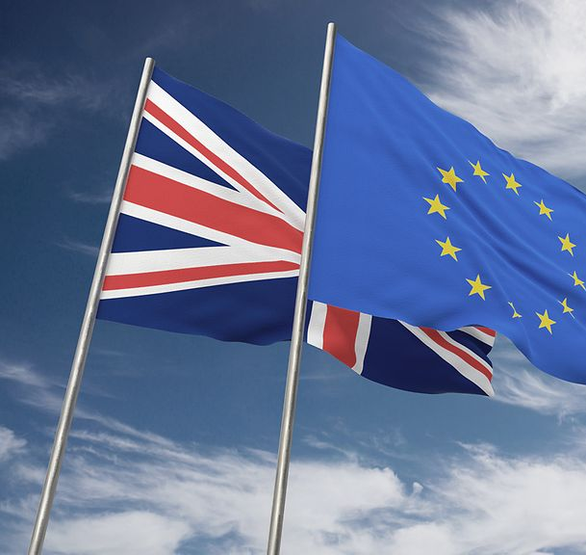
General information
1st of January 1973: Accession of the UK to the European Economic Community (EEC); Predecessor organization of the EU
31st of December 2020: "Brexit" (Made-up word from (Great)Britain and “Exit”)
Article 50 of the Treaty of Lisbon (2007): Exit from the EU is possible → two-year period
Source: https://www.gtai.de/de/trade/specials/special-brexit

Slide 4
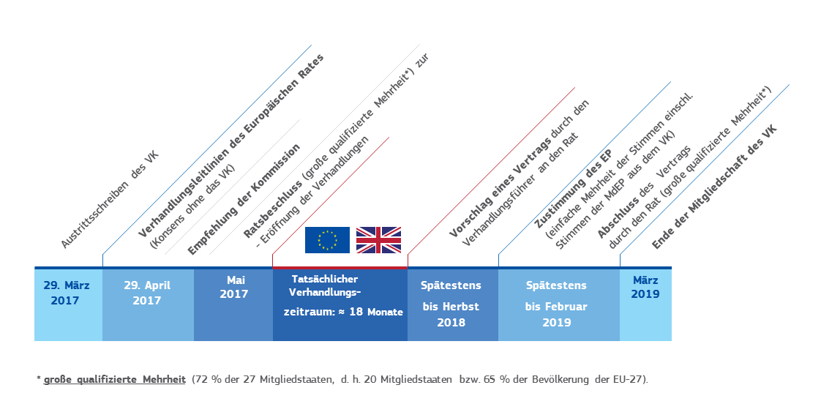
Source: https://ec.europa.eu/commission/presscorner/detail/de/MEMO_17_648
Notes:
On June 23, 2016, a referendum on the country's membership of the European Union (EU) was held in the United Kingdom. 52% of participants voted to leave, 48% voted to remain.
On 29 March 2017, the United Kingdom notified the European Council of its intention to withdraw from the EU, officially initiating the procedure under Article 50 of the Treaty on European Union.
On January 30, 2020, the EU ratified the withdrawal agreement.
At midnight (CET) on January 31, 2020, the United Kingdom left the European Union and became a third country with the entry into force of the Withdrawal Agreement. This began a transition period that ended on December 31, 2020.
On December 24, 2020, the EU and the United Kingdom agreed on a trade and cooperation agreement that reorganizes their future relationship. All 27 member states approved the agreement on December 29, 2020.
On December 31, 2020, the EU-UK Trade and Cooperation Agreement was published in the Official Journal of the European Union. It has provisionally been in effect since January 1, 2021.

Slide 5
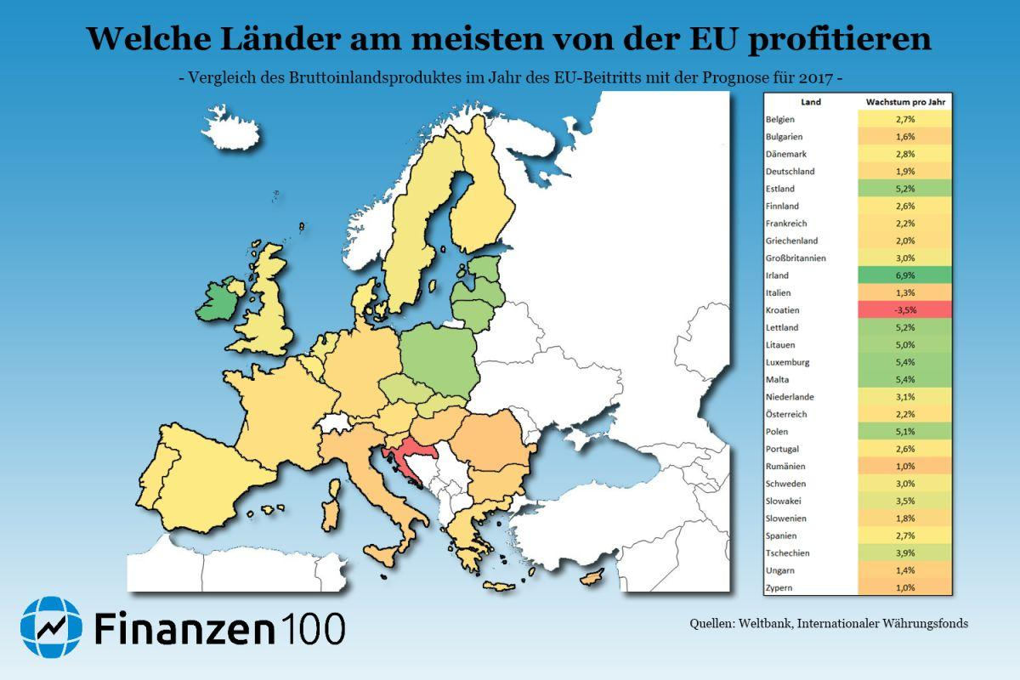
Great Britain before Brexit
not part of the Schengen agreement and the monetary union
no connection to the fiscal pact
Right to “opt out” of legislation (in the area of ​​home affairs and justice)
Part of the free trade agreement
Strengthening Europe's competitiveness
European Security and Defense Policy (ESDP)
Source: https://f100-res.cloudinary.com/image/upload/s--OG_QN4Id--/w_1200/v1/a/public/bkvbxvsdg5fnduedwddg.jpg

Slide 6
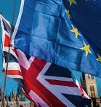
Reason for Brexit
Economy: Net contributor to the EU (mainly pays into the EU budget)
Immigration: many immigrants from EU member states ➞ entitled to social benefits
Centralization and "foreign control": policy areas are not regulated by the politicians elected in Great Britain, but by the EU; EU law is superior to national law
global political independence: no seat in many international negotiations; the EU is conducting negotiations for all member states ➞ demand for proprietary trading
Source: https://www.hwk-muenchen.de/api/public/services/74/imaging/v1/13780/1/t/s;w=1520;h=651;u=true;b=false;f=0.0,0.0/f/c;t=PNG/v07u1P9uP2Q_nCE.pngx

Slide 7
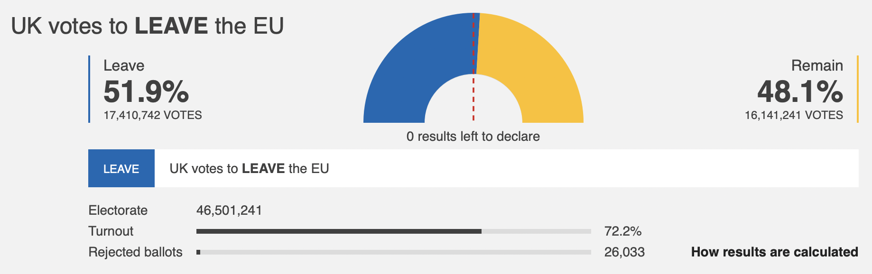
EU-Membership referendum
23rd of June 2016
"advisory character"
registered by 46.5 million people; 72% voted
Supporters of Brexit: 51.9% with 17.4 million votes (mostly England and Wales)
for Remain: 48.1% with 16.1 million votes (mostly Scotland and Northern Ireland)
Source: https://www.bbc.com/news/politics/eu_referendum/results

Slide 8
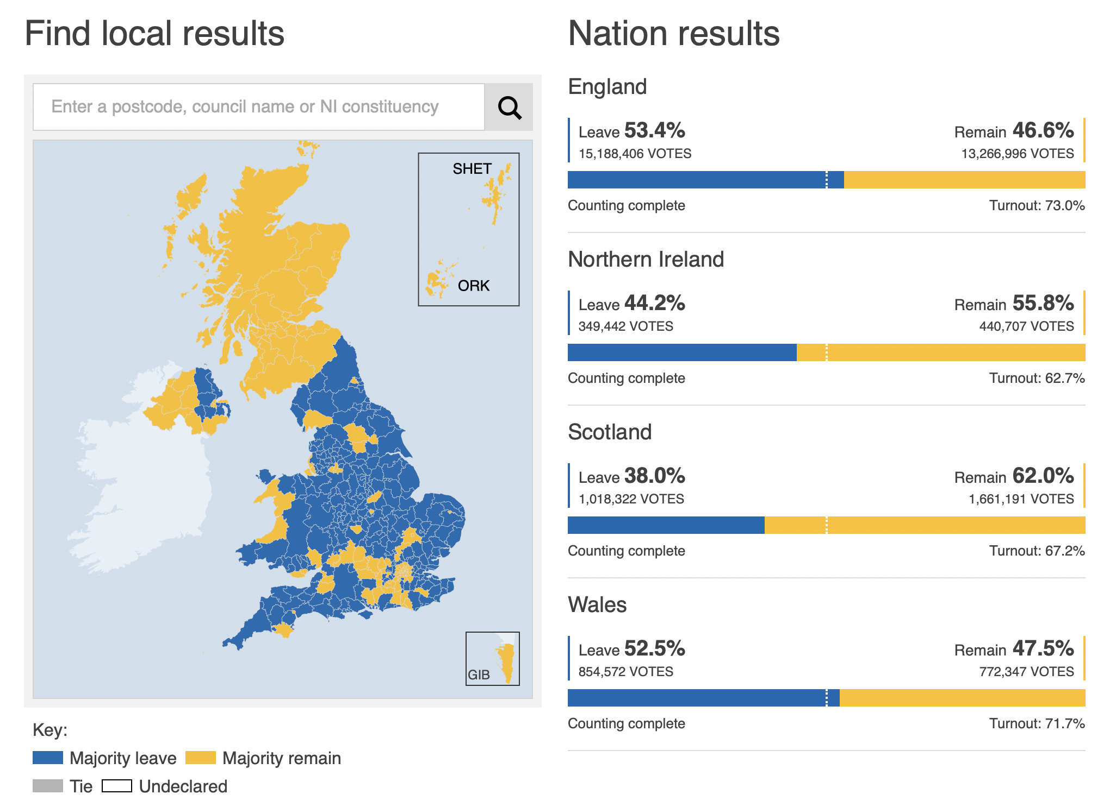

Slide 9
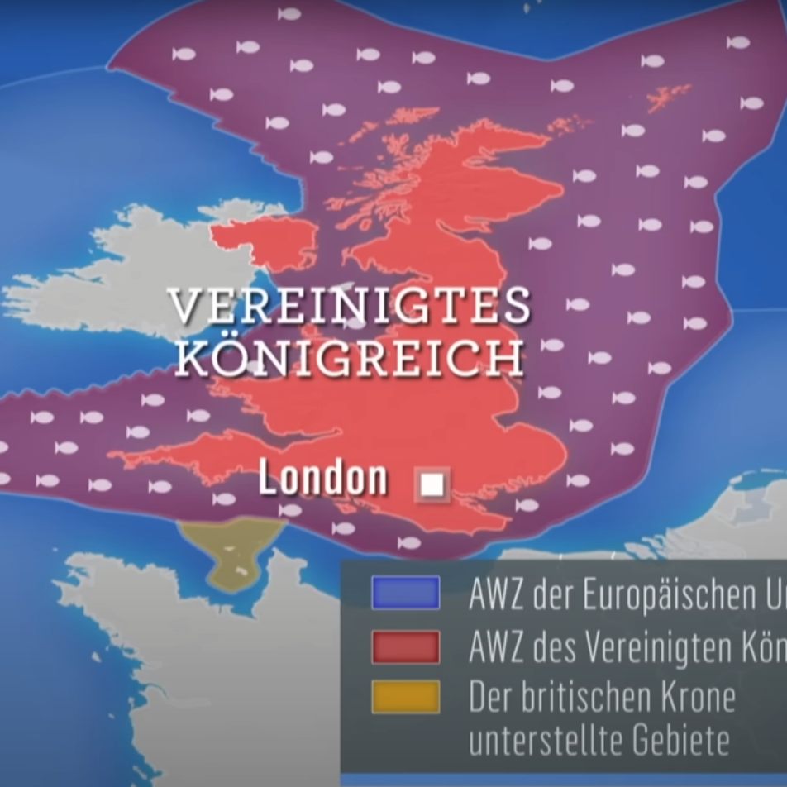
Trade and cooperation agreement
no free movement of people and goods
Control when entering and leaving England
Competition:
Arbitration Court for Fairness
E.g. fishing areas around England
Cooperation between security authorities
Agreement on climate protection and energy

Slide 10
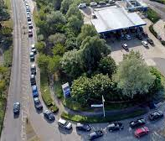
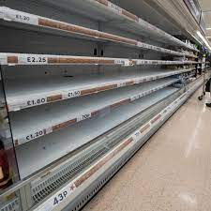
Consequences for Great Britain
Economy:
Exports are still the main player in Europe
Imports were diversified
Labor shortage
politics:
Problems regarding Ireland
Scotland

Slide 11

Consequences for the EU
66.2 million fewer people
➞ therefore 76 fewer parliamentarians
Loss of the 2nd largest economy
➞ approx. 15% of the EU's gross domestic product
Loss of one of the 2 veto rights of the EU in the United Nations
Fears of disputes within Great Britain have arisen
→ resulting with potential conflics with the EU

Slide 12

Sources
https://www.bmbf.de/bmbf/shareddocs/kurzmeldungen/de/was-bedeutet-der-brexit-fuer-bildung-und-forschung.html, last accessed on 20.1.24
https://de.wikipedia.org/wiki/EU-Mitgliedschaft_des_Vereinigten_Königreichs , last accessed on 20.1.24
https://ec.europa.eu/commission/presscorner/detail/de/MEMO_17_648, last accessed on 20.1.24
https://www.youtube.com/watch?v=qUNjWu4gpFs&t=98s , last accessed on 20.1.24
https://www.youtube.com/watch?v=U6NNr79MjUg, last accessed on 20.1.24
https://www.youtube.com/watch?v=VMzlKFPLZOg, last accessed on 20.1.24
https://www.bpb.de/kurz-knapp/hintergrund-aktuell/325314/brexit-handelsabkommen-zwischen-der-eu-und-dem-vereinigten-koenigreich/, last accessed on 20.1.24
https://eur-lex.europa.eu/content/news/Brexit-UK-withdrawal-from-the-eu.html?locale=de, last accessed on 20.1.24
https://www.tagesschau.de/ausland/euaustritt100.html, last accessed on 20.1.24
https://www.treffpunkteuropa.de/pro-contra-grossbritannien-in-der-eu?lang=fr, last accessed on 20.1.24
Quelle: https://www.hamburg.de/image/11828742/kingTeaser/990/420/7fa120b5f50b677bed255b6d920bad4d/AN/brexit---bild--19982972.jpg

Slide 13

Thank you for your attention
https://www.bfdi.bund.de/SharedDocs/Bilder/DE/Themen/Europa_Internationales/Brexit-Flaggen.jpg?__blob=normal&v=3

